Slide 1


Introduction to Water Chemistry & Hardness
Course Code: ETMLCH104
Course Name: Engineering Chemistry
Program: B.Tech. (AI/ML)
Unit 2: Chemical Fuels
Dr. Mehak Ahuja
Assistant Professor, Department of Chemistry
School of Basic and Applied Sciences
K.R. Mangalam University
Sohna Road, Gurugram

Slide 2

Course Overview
UNIT WISE DETAILS ​ ​ ​
Unit Number: 1 ​ | Title: Water technology ​ | No. of hours: 6 ​
Content Summary: ​ Introduction, water analysis: Hardness-determination by EDTA method, Treatment of boiler feed water: Internal treatment (Phosphate, Colloidal and Calgon conditioning). External treatments: Ion exchange and lime-soda process, Zeolite processes. Boiler scales formation and ill effects, methods of prevention of scales. Numerical problems ​
Unit Number: 2 ​ | Title: Chemical Fuels ​ | No. of hours: 9 ​
Content Summary: ​ Fuels: Introduction, classification, calorific value (HCV & LCV), Determination of calorific value of fuel using Bomb calorimeter. ​ Solid fuel: Coal- its analysis by proximate and ultimate analysis, Numerical problems. ​ Liquid fuels: Refining of petroleum, Petroleum cracking, Knocking in IC engine, its ill effects and prevention of knocking. Anti-knocking agent: Leaded and unleaded petrol. ​ Gaseous fuels: LPG, CNG and their applications. ​
Unit Number: 3 ​ | Title: Battery Technology ​ | No. of hours: 10 ​
Content Summary: ​ Introduction - Galvanic cell, electrode potential, EMF of the cell and cell representation. Batteries and their importance, Classification of batteries- primary, secondary and reserve batteries with examples. Battery characteristics - voltage, capacity, energy density, power density, energy efficiency, cycle life and shelf life. ​ Construction, working and applications of: Ni-Cd, and Lithium-ion battery. Working principle of an electric vehicle. ​
Unit Number: 4 ​ | Title: Polymer ​ | No. of hours: 5 ​
Content Summary: ​ Basic concepts of polymer, Types of polymers, Thermoplastic & thermosetting plastics, Preparation and application of some industrially important polymers (Natural rubber, Buna S, Buna-N, Neoprene, Isoprene, Nylon-6, nylon-6,6 , Decron and Terylene). Conducting and biodegradable polymers. ​

Slide 3
COURSE OUTCOMES
CO1: Understand the methods for water hardness and the basics of boiler water treatment and analyze fuel calorific values and battery.
CO2: Explain the characteristics and working principles of different battery types and types of fuels.
CO3: Determine the differences between batteries and fuel cells and classify fuel cell types based on their components..
CO4: Identify between hard and soft water, solve the related numerical problems on water purification and emf and its significance in industry and daily life.

Slide 4

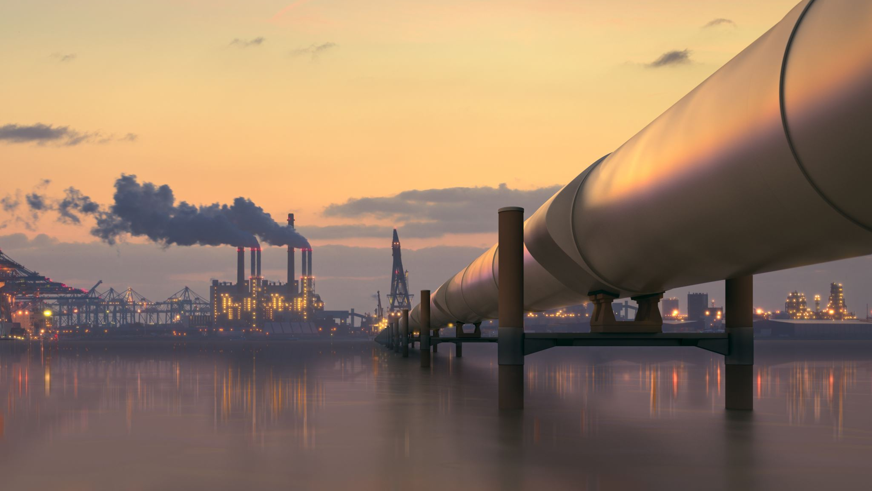

Liquid fuels:
Introduction to Liquid & Gaseous Fuels
Refining of petroleum, Petroleum cracking, Reformation of petrol explanation with reactions, Knocking in IC engine, its ill effects and prevention of knocking. Anti-knocking agent: Leaded and unleaded petrol

Slide 5
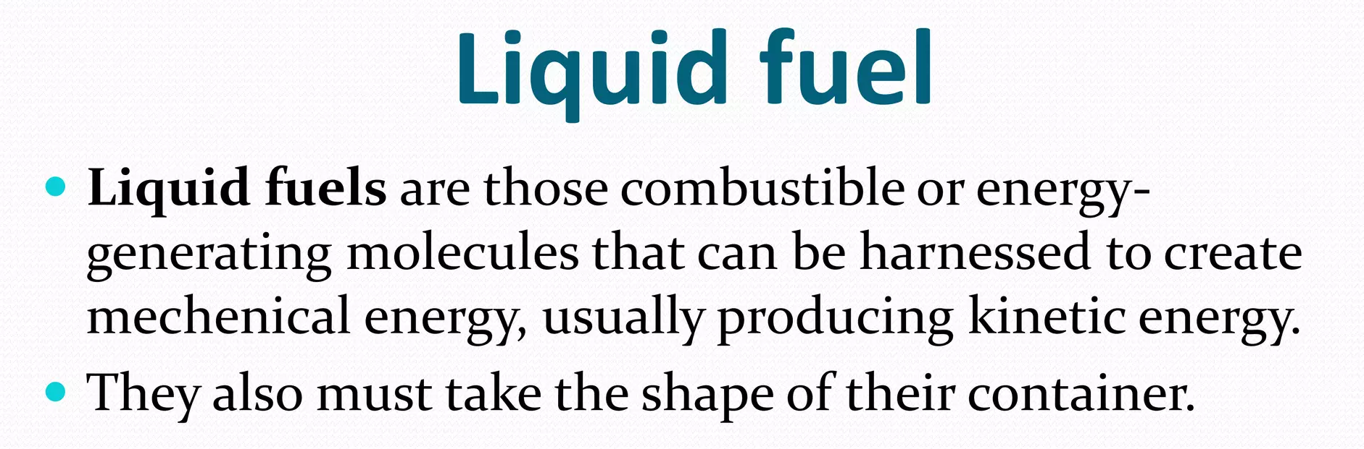
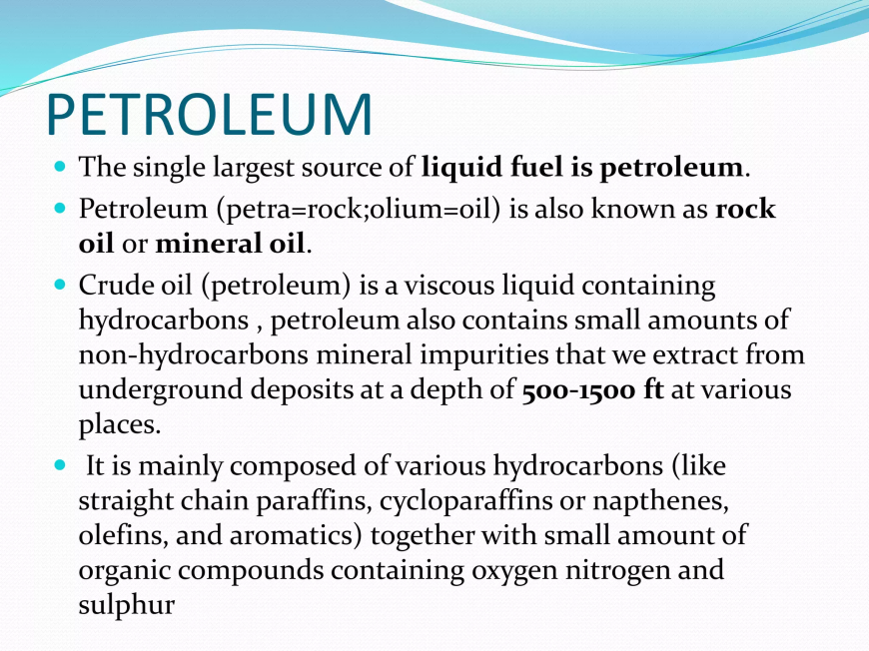
Notes:
New Courses replaced with New Programmes

Slide 6
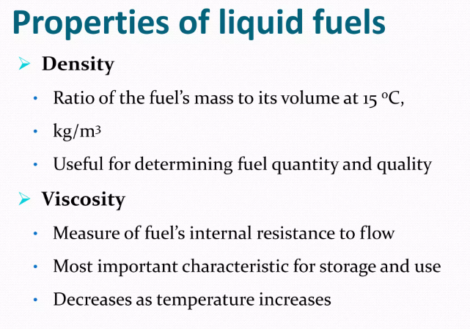

Slide 7
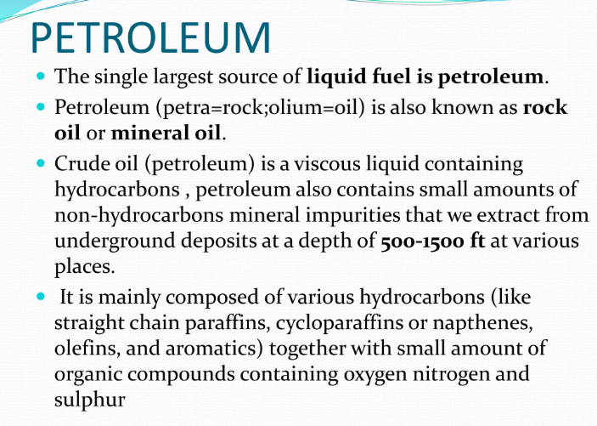

Slide 8
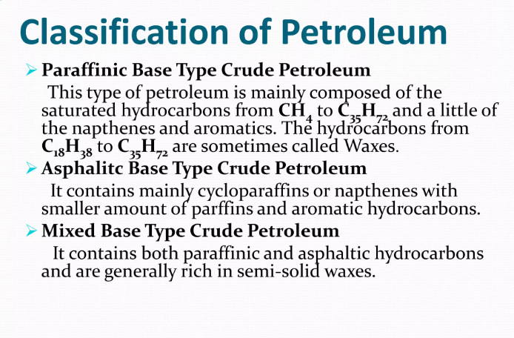

Slide 9
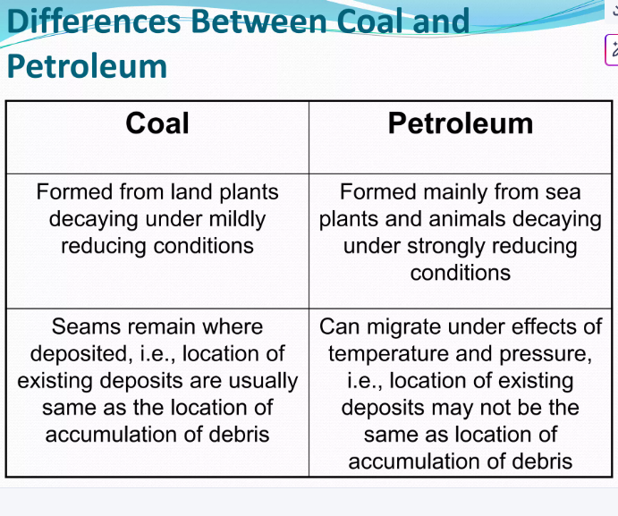

Slide 10
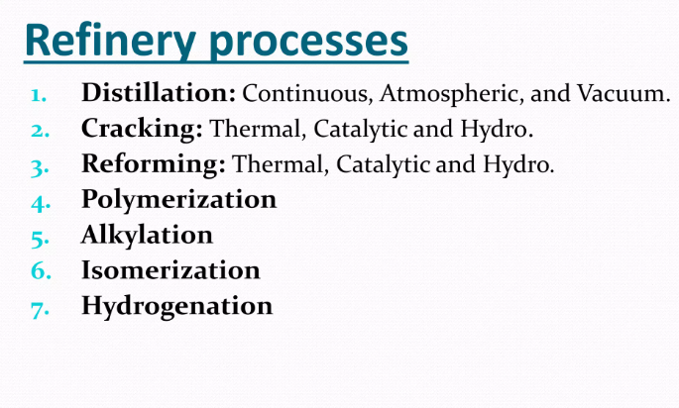
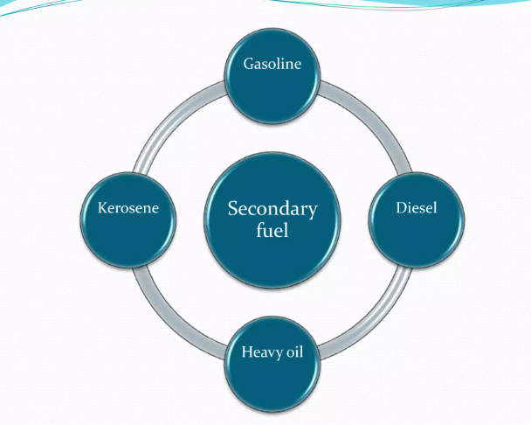

Slide 11
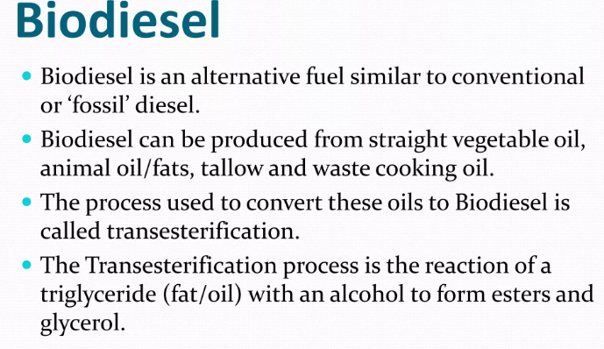
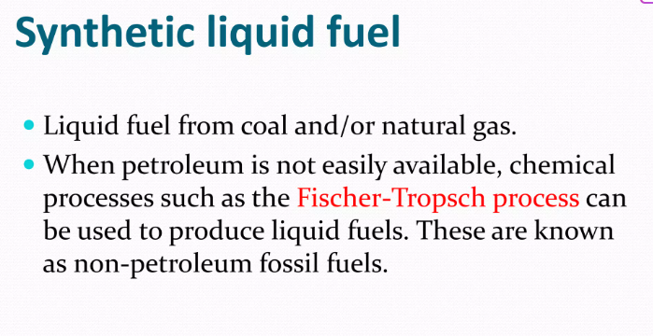
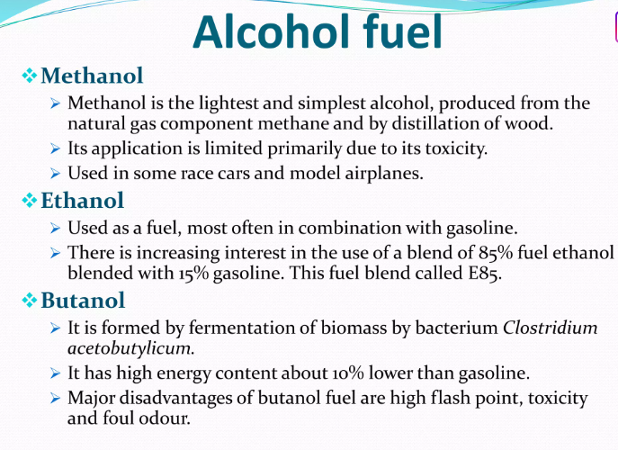

Slide 12
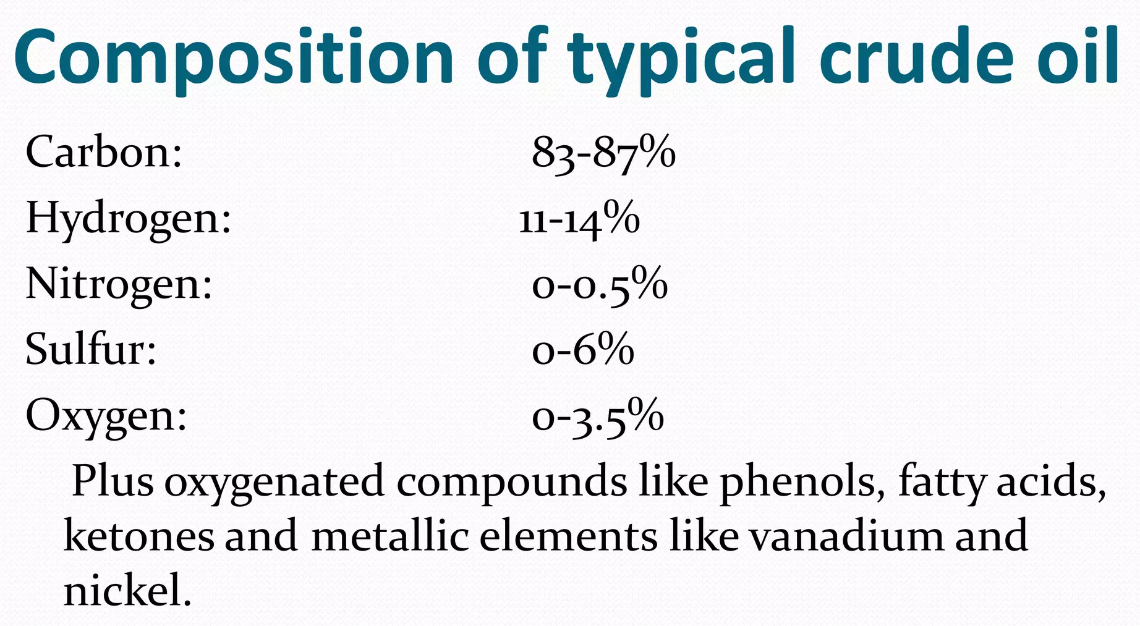
Notes:
New Courses replaced with New Programmes

Slide 13
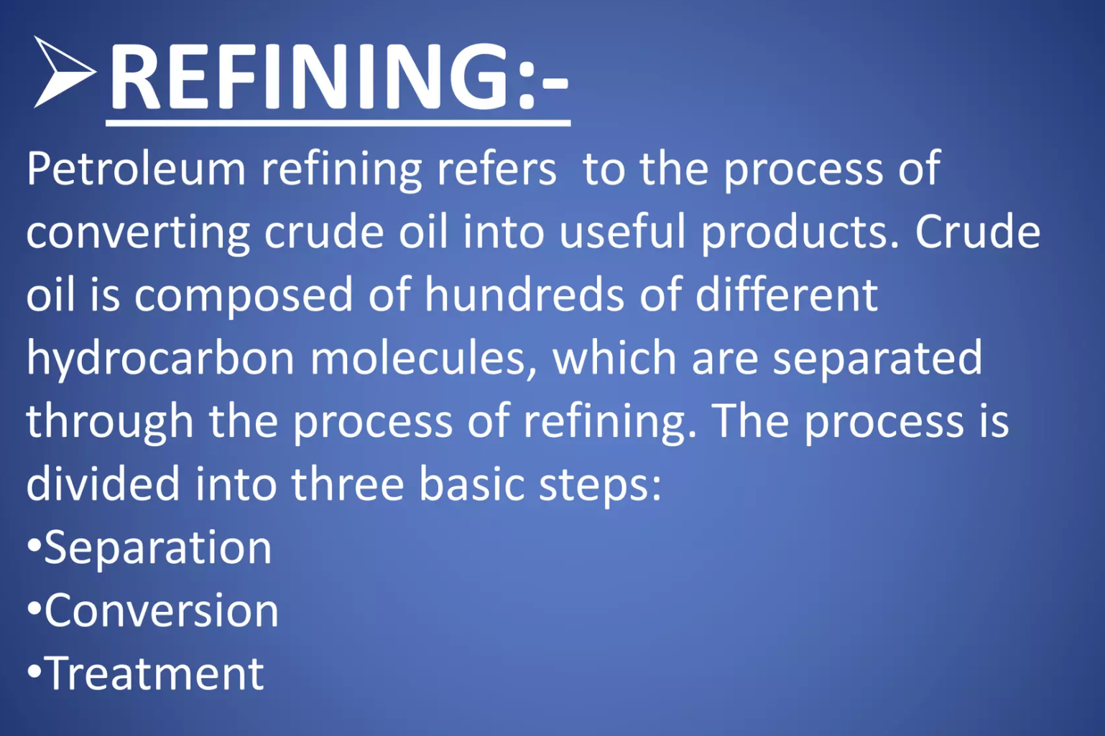
Different techniques for purification of crude oil:
Notes:
New Courses replaced with New Programmes

Slide 14
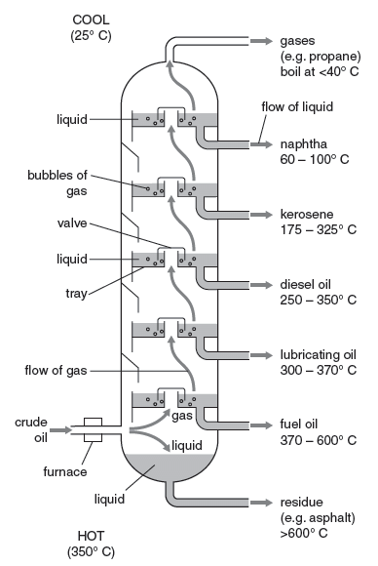
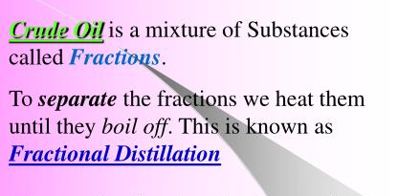
Fractional distillation of Crude oil:
The crude oil is heated in a furnace to over 400ºC. At this temperature, most of the hydrocarbons in the crude oil mixture boil and turn into gas. The mixture of hot hydrocarbon gases passes into a fractionating column which is hotter at the bottom and cooler at the top.
Notes:
New Courses replaced with New Programmes

Slide 15
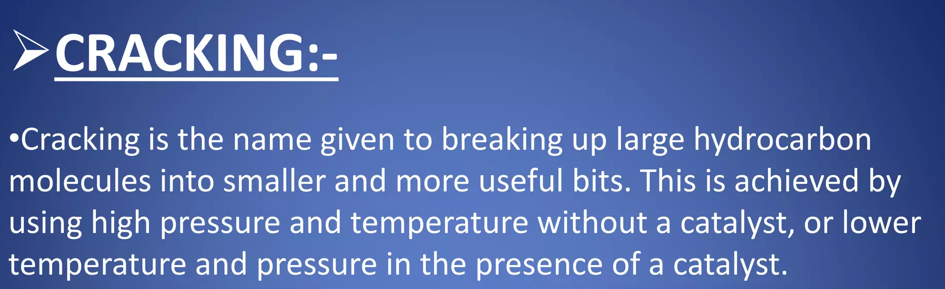
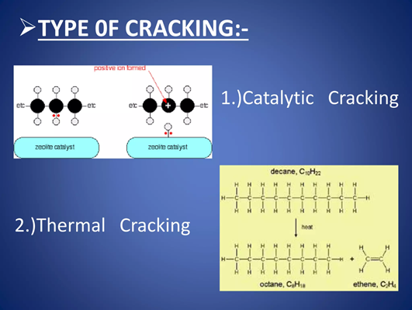
Catalytic
Thermal
Notes:
New Courses replaced with New Programmes

Slide 16
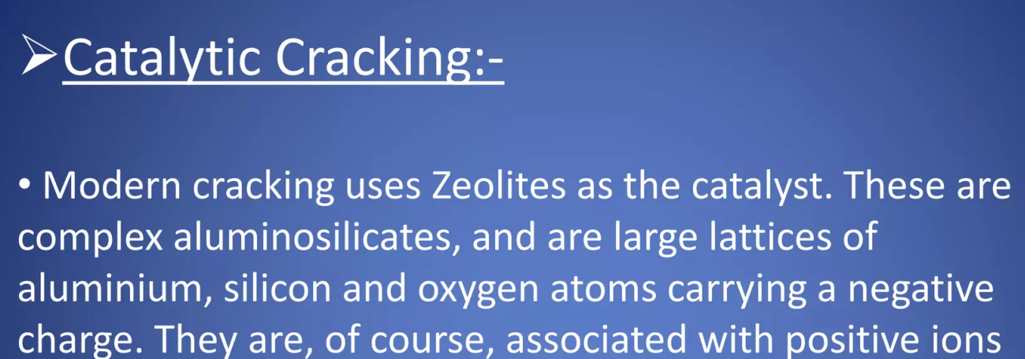
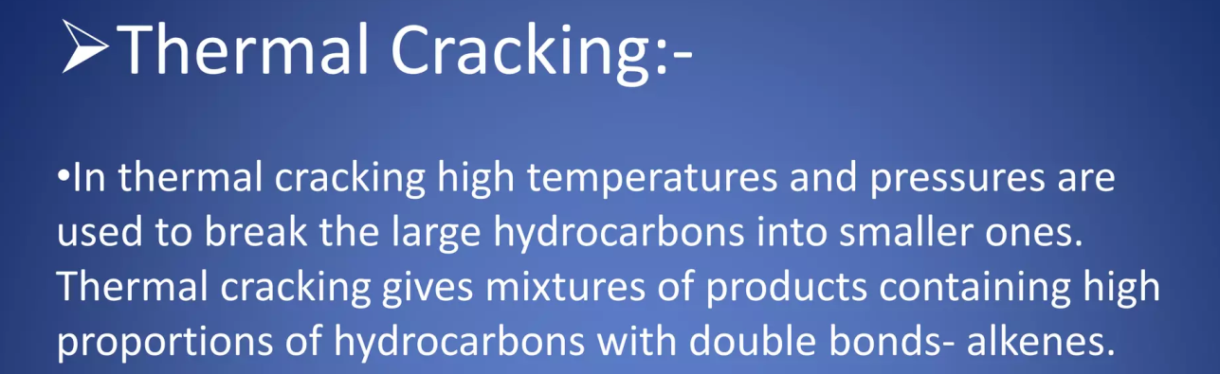
Notes:
New Courses replaced with New Programmes

Slide 17
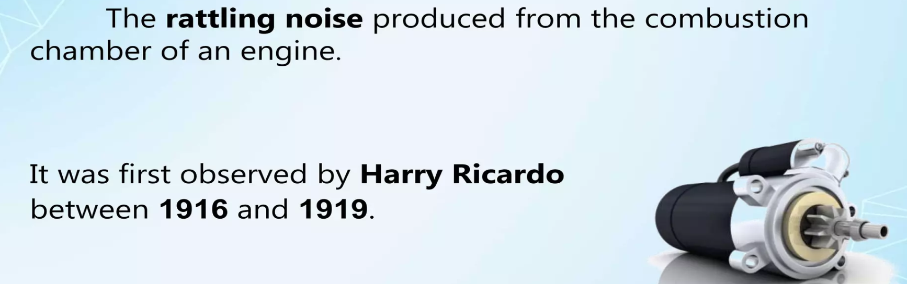
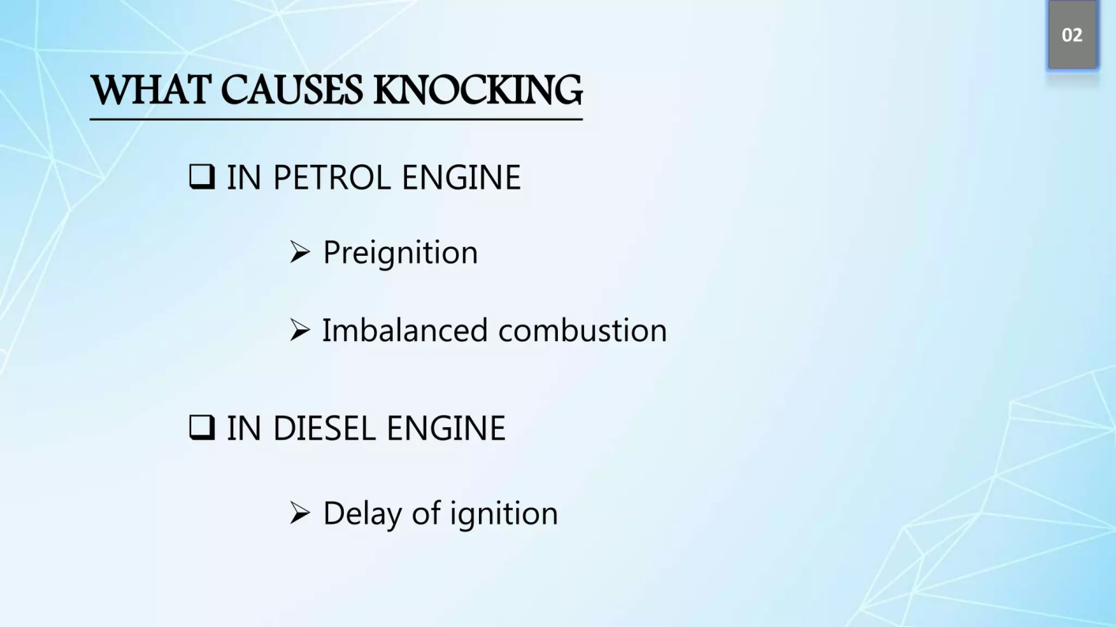
KNOCKING
Notes:
New Courses replaced with New Programmes

Slide 18
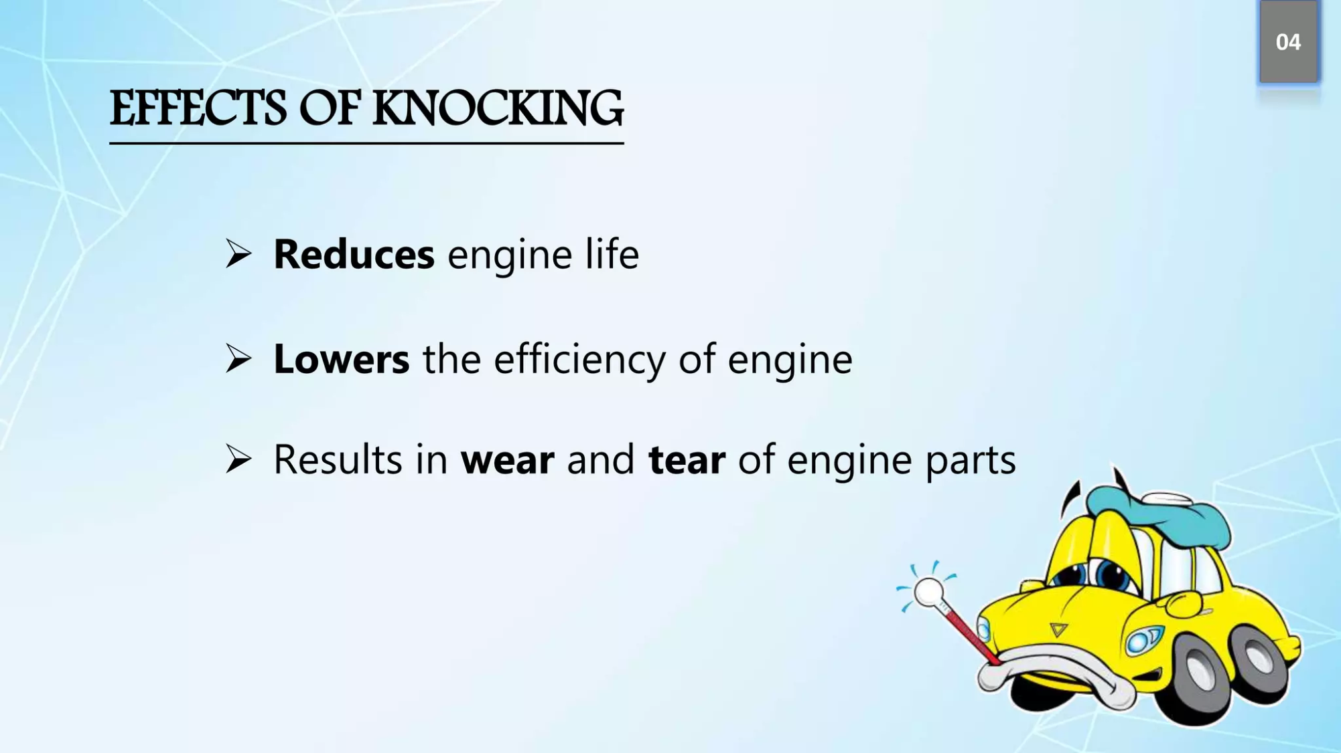
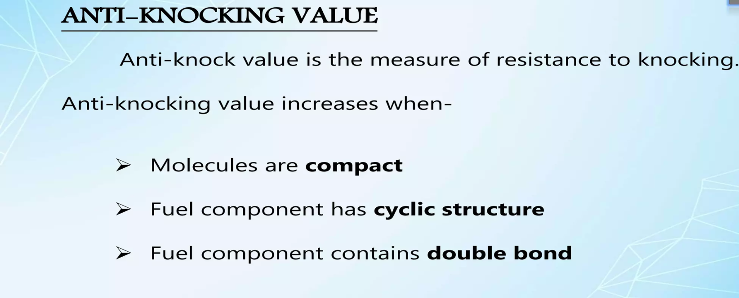
Notes:
New Courses replaced with New Programmes

Slide 19
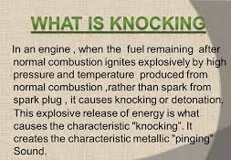
Notes:
New Courses replaced with New Programmes

Slide 20
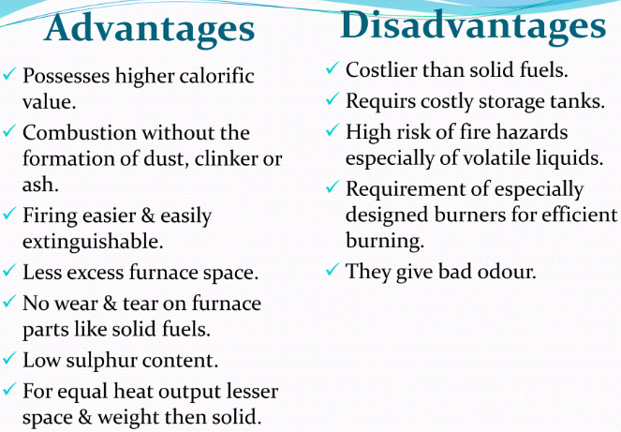

Slide 21
Learning Outcomes
BTL-1: Recall definitions and types of fuels (CO2)
BTL-2: Explain characteristics of solid, liquid, and gaseous fuels;
define calorific value (CO1, CO2)
BTL-3: Apply knowledge to identify ideal fuels and solve questions
related to fuel properties (CO1, CO2)
CO1: Understand the methods for water hardness and the basics of boiler water treatment and analyze fuel calorific values and battery.
CO2: Explain the characteristics and working principles of different battery types and types of fuels.
Mapped Course Outcomes

Slide 22
References
Engineering Chemistry by Jain and Jain.

Slide 23
Antiknock Agents
TEL – Tetra ethyl lead Pb(C₂H₅)₄
Used in the form of ethyl fluid.
Ethyl fluid contains:
63% TEL
26% dibromoethane
9 % dichloro ethane
1-2 ml of ethyl fluid added to 1 litre of petrol increases octane value by 8-10 units.
Notes:
New Courses replaced with New Programmes

Slide 24
Take away of the session
Definition: Fuels that are liquid at room temperature and used primarily in transportation, heating, and industrial processes.
Examples: Petrol (gasoline), diesel, kerosene, fuel oil, and alcohols (ethanol, methanol).
Advantages:
High calorific value
Easy transportation and storage
Clean and smokeless combustion
Easily regulated supply
Applications: Used in vehicles, airplanes, power plants, burners, and internal combustion engines.
Drawbacks:
Costly compared to solid fuels
Risk of fire and explosions
Environmental pollution (CO₂, NOx emissions)

Slide 25
Questions
1. Which of the following is a liquid fuel? A. Coal B. Wood C. Diesel D. Biogas ✅ Answer: C
2. One advantage of liquid fuels is: A. Low calorific value B. Difficult handling C. Easy transport and storage D. Produces more ash ✅ Answer: C
3. Which of these is not a liquid fuel? A. Petrol B. LPG C. Kerosene D. Fuel oil ✅ Answer: B
4. Liquid fuels are commonly used in: A. Wood stoves B. Blast furnaces C. Internal combustion engines D. Charcoal kilns ✅ Answer: C
5. Which of the following is a disadvantage of liquid fuels? A. High ash content B. Cannot be pumped C. High fire risk D. Low efficiency ✅ Answer: C

